Slide 1

Healthcare Management Organization
Team 2:
Aditi Pala
Indra Ariunbold
Rujuta Mirajkar
Jaineel Parmar
Rithvik Segu

Slide 2
Agenda
Introduction
Overview
Data Reading
Models
Recommendations & Limitation
Conclusion

Slide 3
Healthcare Management Organization
Based on the given data, the case's main objective is to offer actionable insight and precisely estimate which person’s healthcare cost will be expensive.
The dataset includes statistics on healthcare expenses from an HMO (Health Management Organization). In the dataset each row represents a person.
Our team's objective is to comprehend the primary reasons, why some individuals spend more on health care(i.e., require more medical attention) and to forecast which individuals will be expensive (in terms of medical expenses).

Slide 4
Model Flow of the Project
UNDERSTANDING KEY DRIVERS IN DECIDING HEALTHCARE EXPENSIVENESS
Analyzing Data
to determine which factors to choose
Running the models -
1. SVM
2. KNN
3. Logistic
4. Neural Network

Slide 5
Problem Statement
To predict who will spend a lot of money on health care in future.
Segregating health care costs as expensive or not expensive based on location and location type.
Provide actionable insight to the HMO, in terms of how to lower their total health care costs, by providing a specific recommendation on how to lower health care costs.

Slide 6
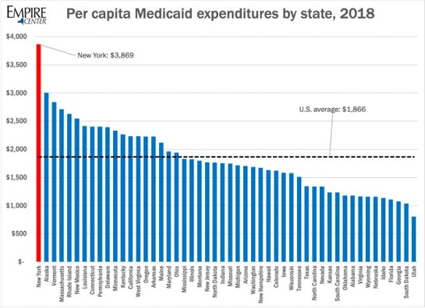
-Different states in the US have different average healthcare costs
-Earnings of each individual has not been provided.
Hence it is important to have threshold by each state rather than having one threshold for the entire dataset

Slide 7
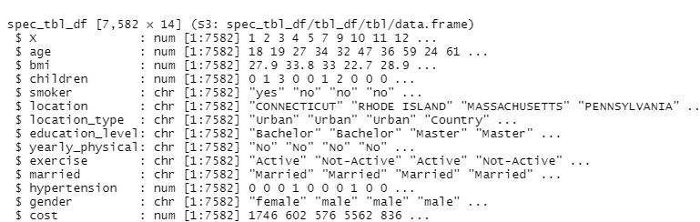
Technical Details
Cost, Location, Location Type are few of the most important variables.

Slide 8
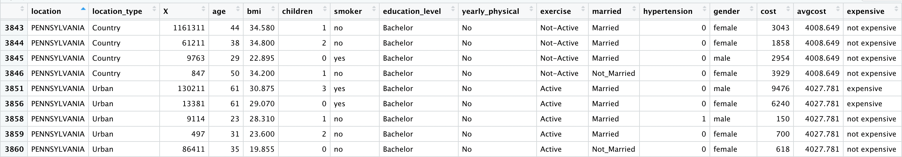
Deciding Factor in Expense Report
Dataset after deciding whether person's healthcare costs are expensive or not expensive

Slide 9
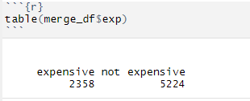
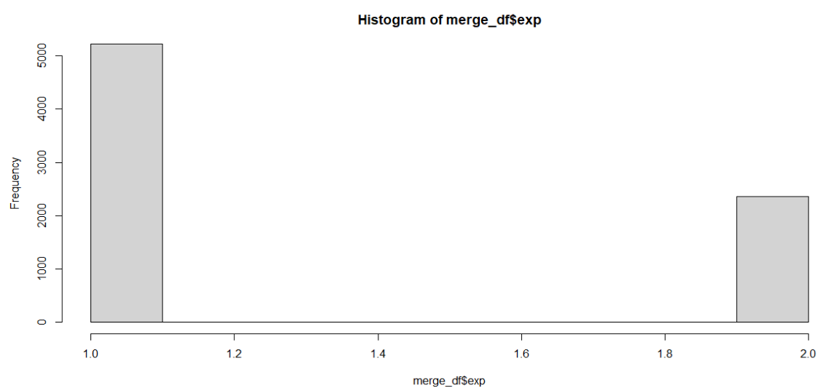
Expensive vs Non-Expensive Graph
Based on dataset of 7582 attributes 2358 are expensive and 5224 are not expensive.

Slide 10
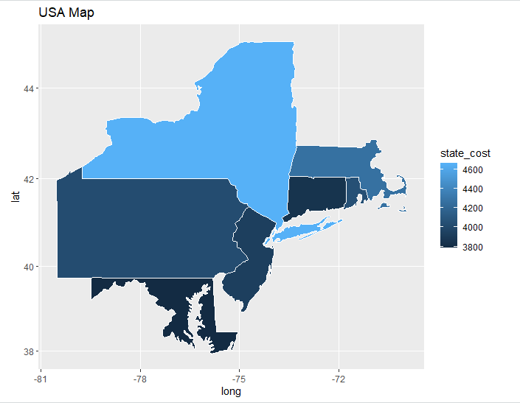
Geographical Represenation of Expenses
New York has the highest average cost.
The least average cost expense is for Maryland state.

Slide 11
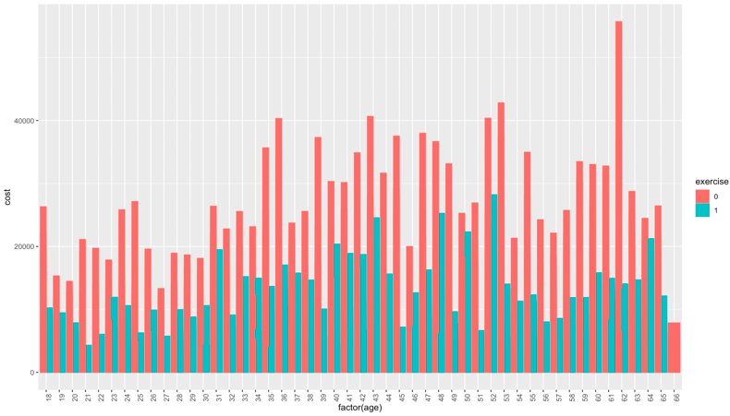
Expensive healthcare costs
Here we can see trend analysis of age vs cost of healthcare for individuals who are not exercising regularly that are paying greater than average healthcare cost.

Slide 12
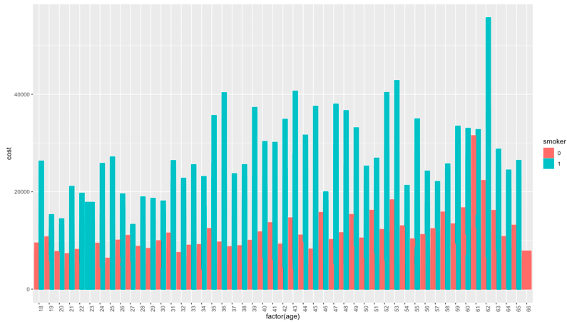
Expensive healthcare costs
Here we can see trend analysis of age vs cost of healthcare for individuals who smoke regularly that are paying greater than average healthcare cost.

Slide 13
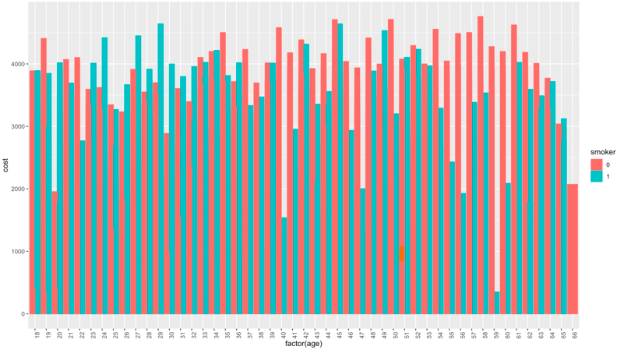
Non expensive healthcare costs
Here we can see trend analysis of age vs cost of healthcare for nonsmoker individuals paying less than average healthcare cost.

Slide 14
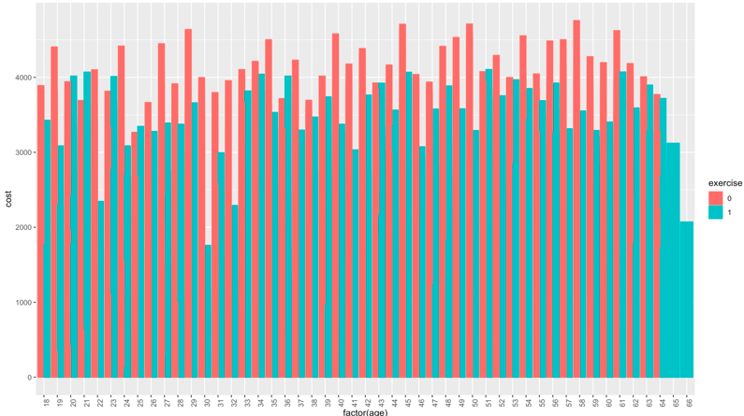
Non expensive healthcare costs
Here we can see trend analysis of age vs cost of healthcare for individuals who exercise regularly that are paying less than average healthcare cost.

Slide 15
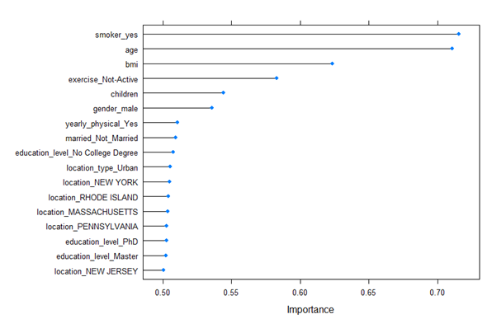
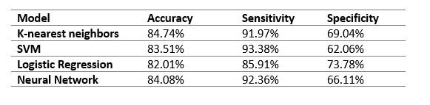
Analysis of all models

Slide 16
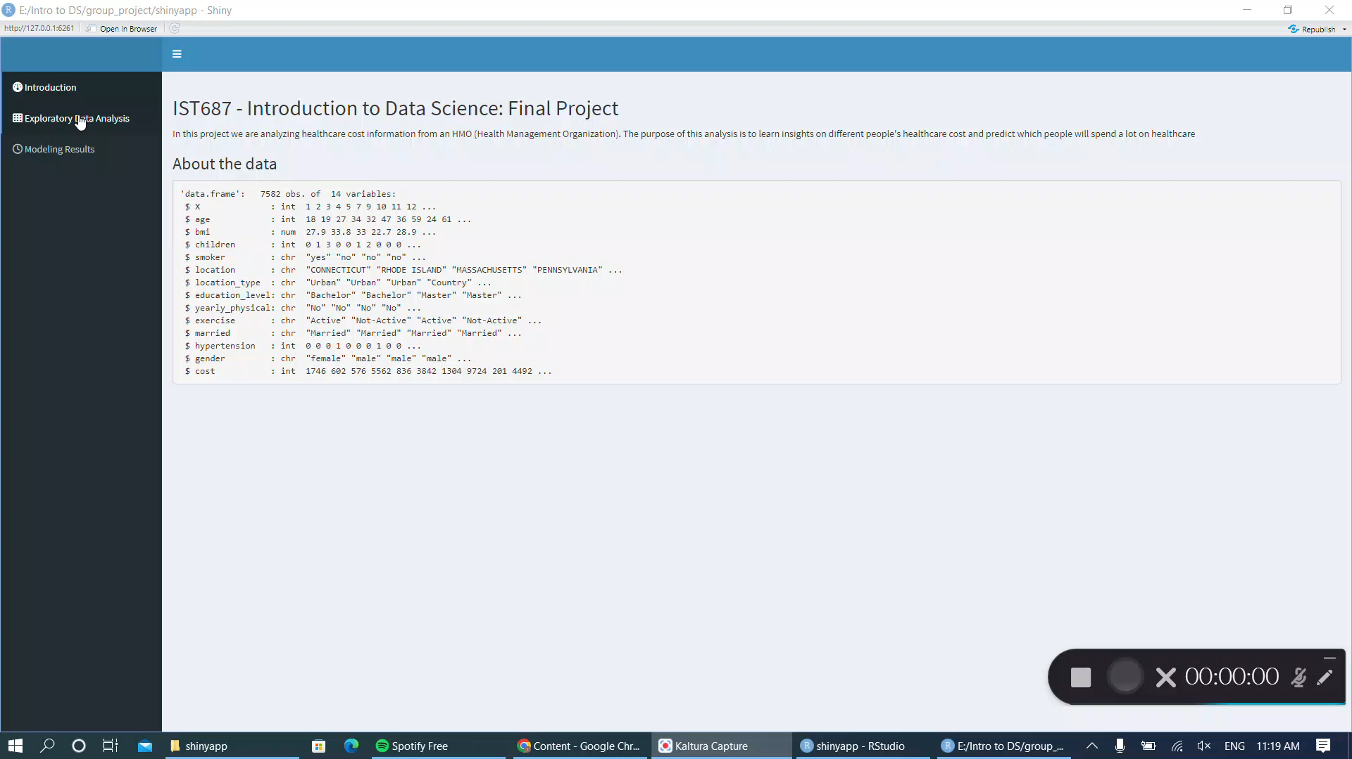
Shiny app

Slide 17
Recommendation & Conclusion
Identify smokers and help them quit smoking in various ways, such as by recommending programs, patches and other solutions.
Identify people who could benefit the most from daily exercising and recommend possible at-home routines, or fitness facilities close to their home
Remind especially at-risk people to get yearly check ups done

Slide 18

Thank You

